Slide 1
English Discoveries with TOEIC® Tests
Effective Learning, Measurable Success

Slide 2
Section 1: What is TOEIC?

Slide 3
TOEIC® Family of Assessments The most popular assessment of workplace English in the world
USED IN 150
COUNTRIES
~14,000
ORGANIZATIONS
USE THE TOEIC® TESTS
~7 MILLION
tests administered annually
30+
YEARS AS INDUSTRY
LEADER
7
10
OF
THE
LARGEST
COMPANIES RELY ON IT

Slide 4
Test Format - TOEIC
TOEIC (approx. 2 hours) B2-C1 Listening Comprehension 100 items
Question-Response: 30 questions
Conversations: 30 questions; 10 conversations with 3 questions each
Talks: 30 questions; 10 talks with 3 questions each
Reading Comprehension: 100 items
Incomplete Sentences: 40 questions
Text Completion: 12 questions
Single Passages: 28 questions; 7–10 reading texts with 2–5 questions each
Double Passages: 20 questions; 4 pairs of reading texts with 5 questions per pair

Slide 5
Real World English: Listening
International Travel
Respond to questions in hotels and airports
Order food in a restaurant
Change money in a bank
Buy gifts in a store
Get directions
Social and Work Situations
Make introductions and greetings
Check other people’s names and backgrounds
Take and leave phone messages
Follow instructions from a supervisor or team member
Participate in a job interview
Seek phone customer service help
In daily life
Find out a store’s opening hours
Visit a doctor
Find a place to live in a new town or country,
Conduct transactions at banks of post offices

Slide 6
Real World English: Reading
In daily living situations
Pay bills
Read advertisements and special offers
Find a place to live n a new town or country
In social and work situations
Read a postcard/email from a friend or colleague
Read a short thank you note
Follow directions
Read and answer work-related emails
Use the internet
In international travel situations
Respond to questions on travel documents
Read a menu
understand travel recommendations
Follow signs and directions

Slide 7
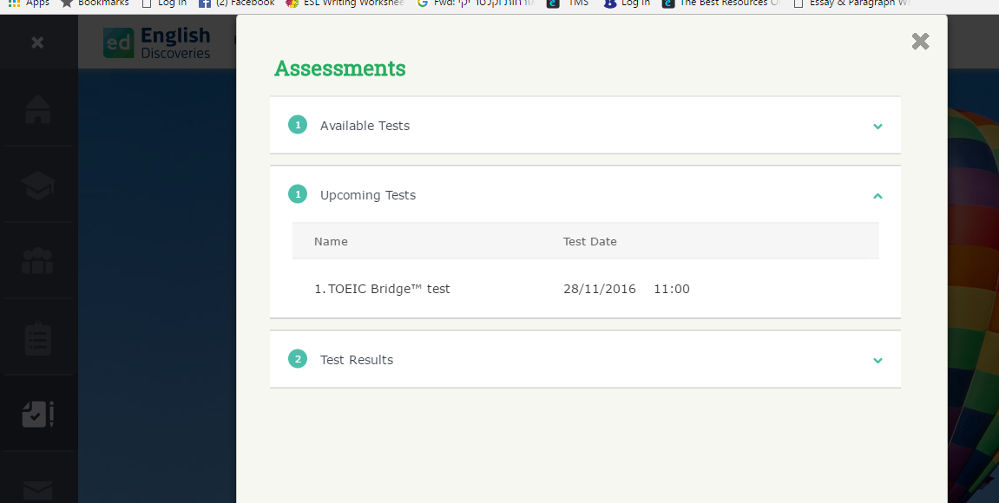
Accessing the test for the Student
Home Page
Assessments

Slide 8
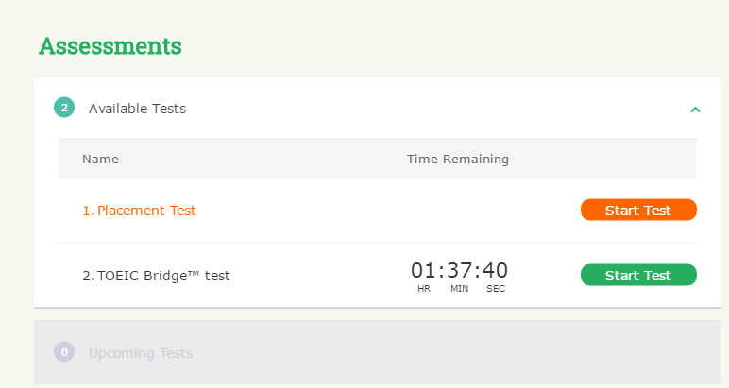

Slide 9
For more information please you can write me to monica.espinoza@ujcv.edu.hn
ETS, the ETS logo, GRE THE PRAXIS SERIES, TOEFL and TOEIC are registered trademarks of Educational Testing Service (ETS), used under license. TOEIC BRIDGE is a trademark of ETS. All other trademarks are the property of their respective owners.

